Slide 1

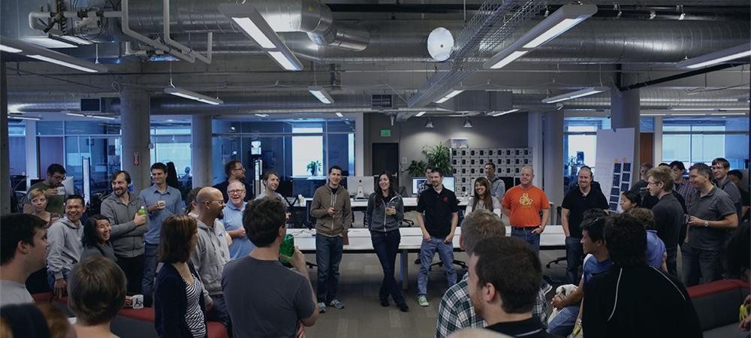
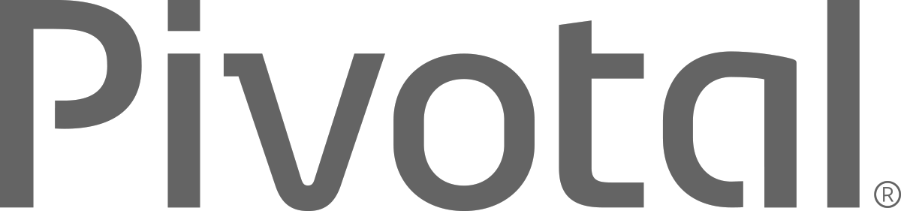
Introductions
Name, Team, Apps

Slide 2


Cloud Native Applications
Workshop Introduction
Notes:
I want to talk to you about cloud native applications, microservices and the platforms for bringing them to production

Slide 3
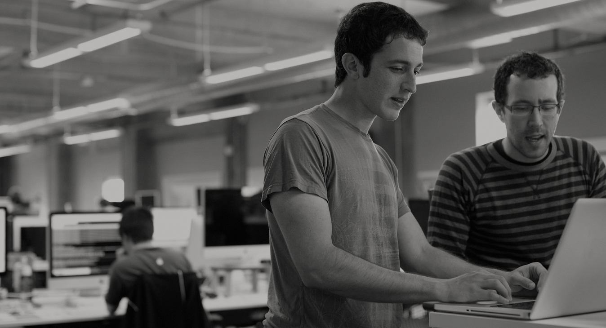

WE BELIEVE
Transforming how the world builds software will shape the future.
Notes:
At Pivotal, we believe Transforming how the world builds software will shape the future.
This is our core guiding principle that shapes our product and corporate strategy. Our success today is your success five years from now. With the ever expanding innovation gap between companies stuck with the status quo, and those companies pivoting with new practices and technology gaining the market, staying competitive means transforming at the core of the business, and in today’s world this core is not just the technology that runs the datacenter anymore, rather its the software development loop that cradles the market innovations, and the operations loop which enables innovation to flow freely. Achieving agility in dev and ops is the keystone to success in a rapidly growing technology space increasingly dominated by lean startups.

Slide 4
Agenda
Changing Development Models
Cloud Native Application Platforms
Pivotal Cloud Foundry
Notes:
I wanted to go over some of these emerging development models and
how tech companies have been successful in moving to these highly composable, resilient application architectures that we’re referring to as cloud native applications.
I want to show you what kind of platform tools the leading tech companies had to build.
And how these new designs are really hitting a lot of enterprises, companies that don’t depend on software directly.
We also want to showcase how these projects work together with a demo of a microservice-based Java app, built with Spring Boot and Netflix OSS projects
Before we turn it over to discussion

Slide 5
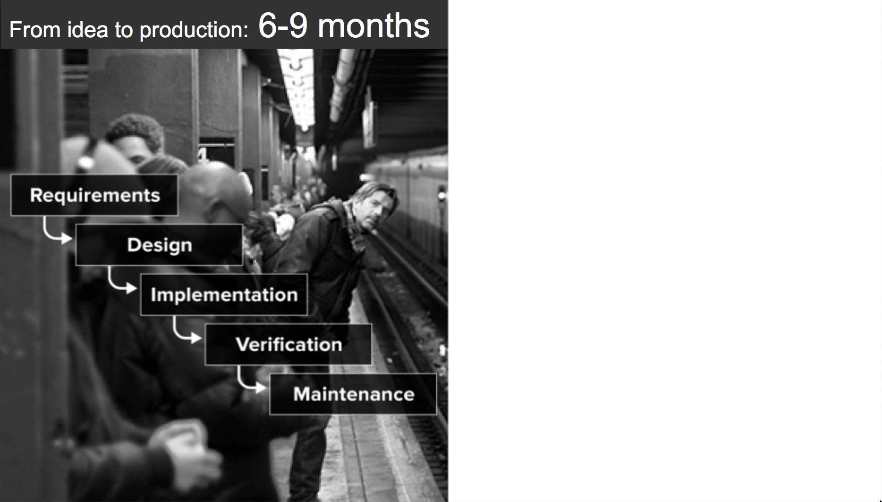

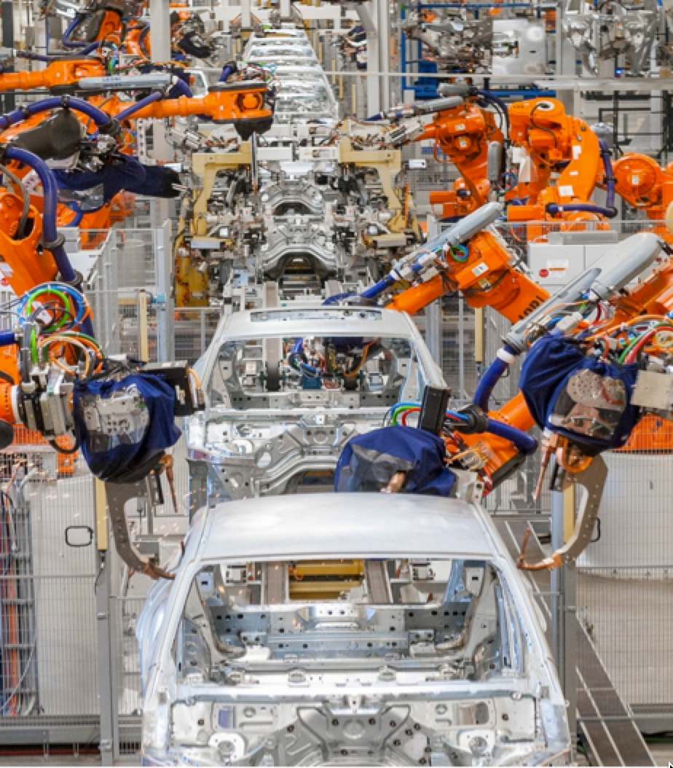

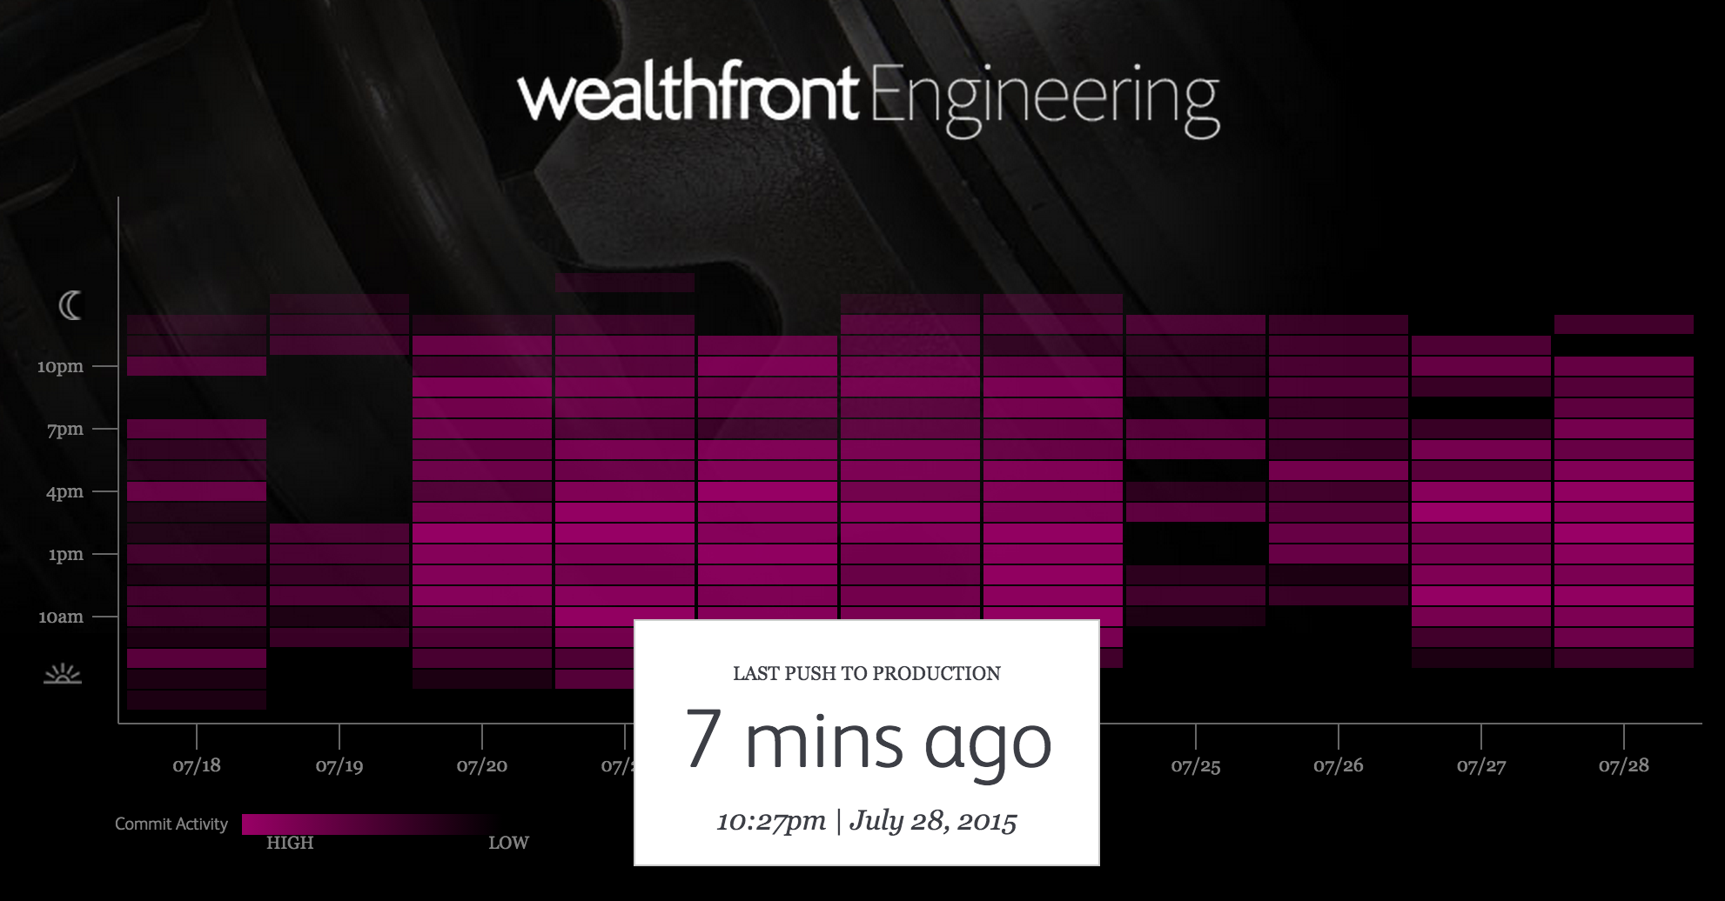
An idea in the morning, is running in production by evening
Then
Now
Notes:
Lets begin the conversation with contrasting the past with the present. Using the auto industry as a backdrop, we examine at how industrialization changed manufacturing for good, and companies were forced to pivot to a new technology, new processes, or hold on to the status quo and fail.
A&E – Corporate IT and Broadcast Engineering
Ford Assembly Line from back in the day. Today fully automated
Wealthfront engineering: known for having pivoted away from practice that were slowing them down, to embrace a new agile CI/CD deployment and delivery model that is fully automated. Changing release cycles to minutes instead of days or weeks.

Slide 6
DevOps
Continuous Delivery
Microservices
Not my problem
Separate tools, varied incentives, opaque process
Release once every 6 months
More Bugs in production
Tightly coupled components
Slow deployment cycles
Shared responsibility
Common incentives, tools, process and culture
Release early and often
Higher Quality of Code
Loosely coupled components
Automated deployments

Slide 7
Developers Spend Time NOT Writing Software
Design and Coding
Brainstorming
Administrative tasks
Managing Environments
Waiting for Test/Build
Average Hours/Week
17.5 hrs ~ 40% of full work week!
Sources: “Electric Cloud LinkedIn Survey to software developers”

Slide 8
Cloud Foundry Helps Close the Innovation Gap
Key Performance Indicators for Market Leadership
Agile/Developer Productivity/TDD
Continuous Delivery
DevOps
Cloud-native App Design
Culture/Talent
Startups
DevOps, CD, Agile
Enterprise PaaS
Expectations
&
Efficiency
Innovation Gap
DIY Automation
IaaS
Traditional IT
Time

Slide 9
Software Developers Spend too Much Time NOT Writing Software
Design and Coding
Brainstorming
Administrative tasks
Managing Environments
Waiting for Test/Build
Average Hours/Week
17.5 hrs ~ 40% of full work week!
Sources: “Electric Cloud LinkedIn Survey to software developers”
Notes:
And here’s the reality.
You have a precious resource that’s spending TOO much of their time, not doing what you hired them to do. And for good reason.
How much then is the value of each developer’s key stroke to meeting innovation strategy targets? Protecting the developer’s ability to execute on innovation is key to realizing value from investment in top talent.

Slide 10
The Developer DREAM Haiku
Here is my source code,
Run it in the Cloud for me,
I do not care how
Notes:
An important and in-demand resource these days – Your developers. This is what they really want – to execute on innovation strategic goals without the burden of repetitive tasks, outdated process, and technology which only creates barricades in front of their mission to get into the flow.

Slide 11

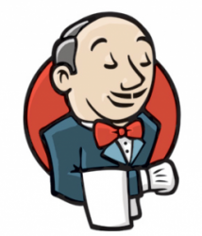
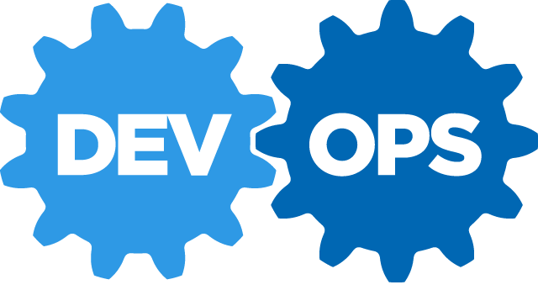
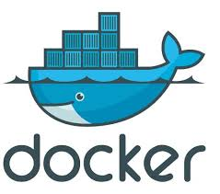
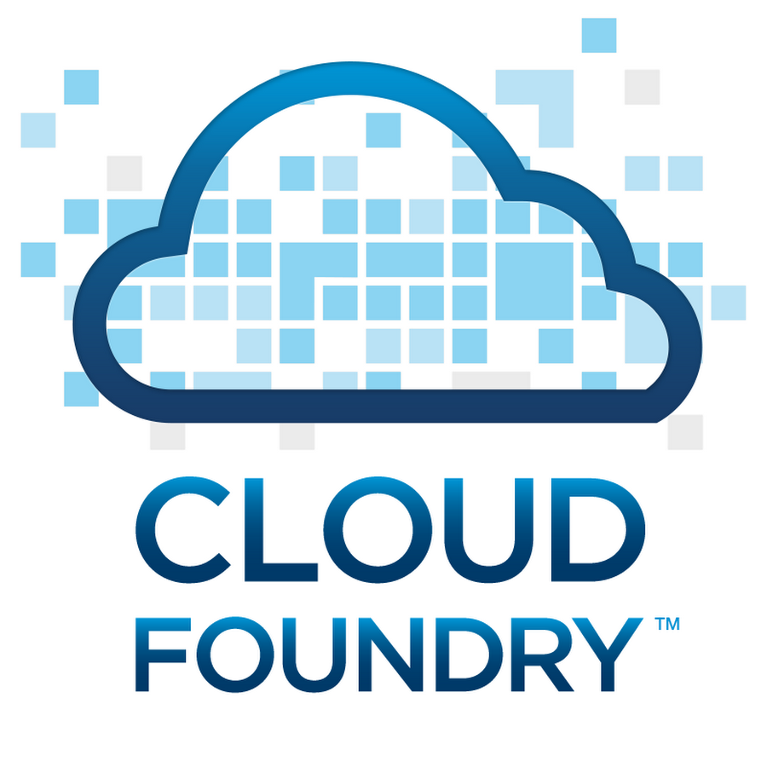
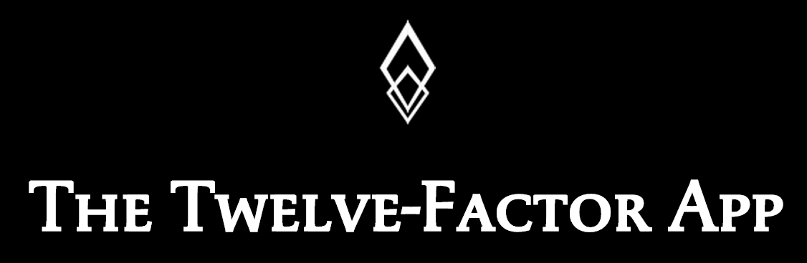






Software is EVOLVING
Continuous Delivery
Spring Boot

Slide 12
The IT Operator REALITY
It's not enough just to deploy something
That's only Day One
You have to deploy again and again and again
Notes:
Too often we forget how important it is to look head. Company culture which values instant gratification above long term success falls into the trap of dream today, a nightmare tomorrow. The reality is that more work now will lead to less work later. So while deploying, not only think of the task at hand, but plan for tomorrow, for 5 years from now. Thinking about day2, year2, and 5 years out, deployment on day one is not enough anymore, its a long term field of view which will ensure success – so build for day two!

Slide 13
IT Ops Spends Time Building Snowflakes
IT Operations on a Cloud Native Platform
Request VMs
Request Network
Request Software Install
Request Database
Random Network Troubleshooting
14
0
0
4
0
4
8
DAYS
0
0
6
0
15
Nearly 6 months later
11
30
15
0
0.02
2
30
0.02
60
Random Middleware/OS Troubleshooting
Develop App
User Acceptance Testing
QA/Production Deploy Pipeline
Scale Up/Down
Need to Innovate Here

Slide 14





Building a Cloud Native Platform
Choosing a
Metrics
SSO
Data
Load
Balancing
CI/CD
Java/.NET
Microservices
Spring Boot
Netflix OSS
Developer AND
Operator Agility
True Multi-cloud
Portability
Pivotal Cloud Foundry
Elastic Container Runtime
DIY Tooling:
Puppet
Chef
Ansible
Cloud formation
Terraform
Rancher
…
OS
Container Orchestration
Cloud Orchestration
CPI
Azure
14

Slide 15




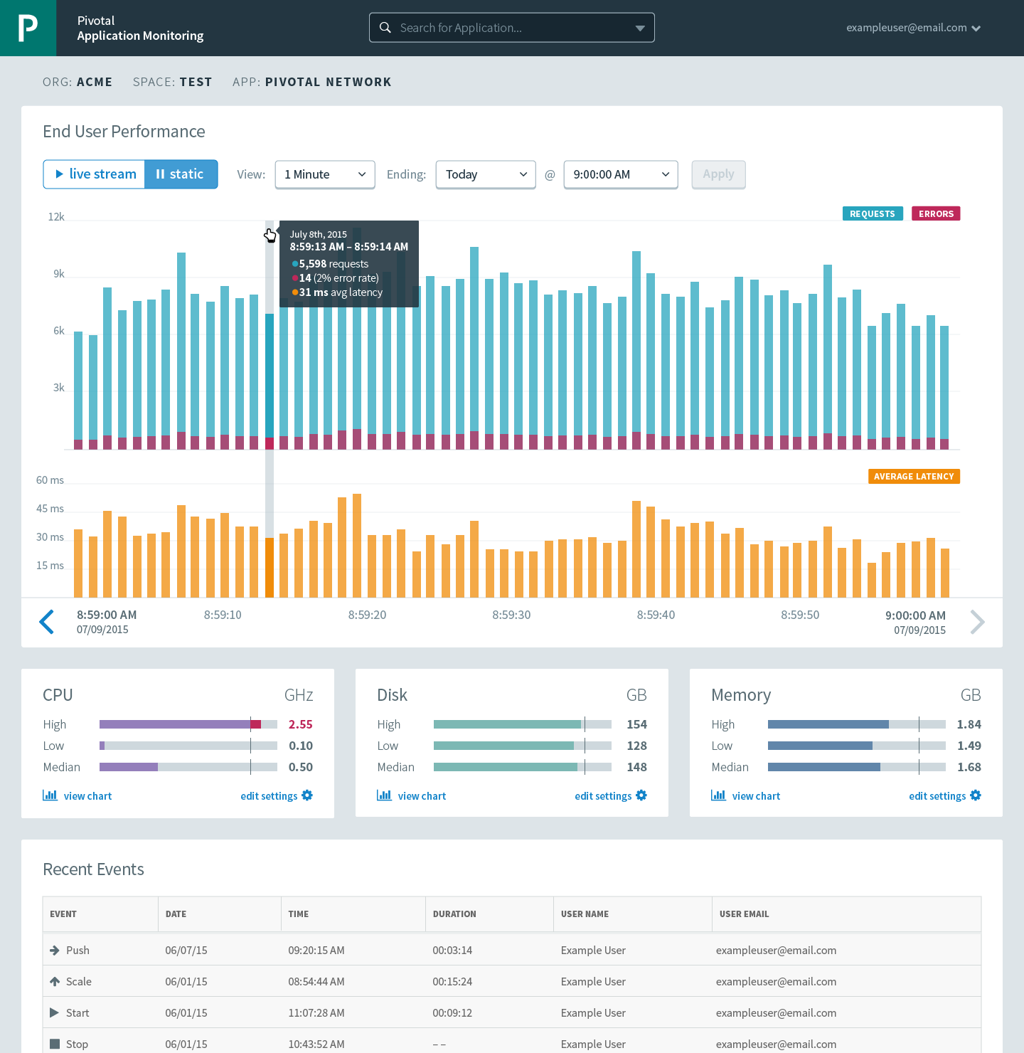


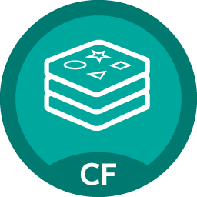

Cloud Foundry: An App-centric Platform
Roles & Policy
Centralized Log Management
Networking
& Load Balancing
Auto-Scaling
APM & Tracing
APPLICATION
Health management
Marketplace

Slide 16


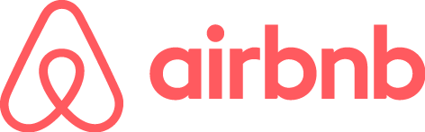



Software is changing INDUSTRIES
$6BN
Financial Services
$53BN
Entertainment
$26BN
Hotel
$34BN
Automotive
$50BN
Transportation
$3.2BN
Industrial Products
Notes:
Now, you might have seen some version of the story where several Silicon Valley companies are disrupting traditional industries and creating tremendous value.
Uber has no cars, AirBnB owns no real estate, Facebook doesn’t generate content and Amazon has no retail stores. This is all based on software. And that’s really a great story
To be honest, the only companies on this slide I have never used myself are a Tesla, and a Nest, however the ones I do use have saved me alot of money. How can a business offer a better service, faster, and cheaper for themselves, and me? The key is agility.
--
The first law of disruption? Disruption is inevitable. However it is avoidable!

Slide 17



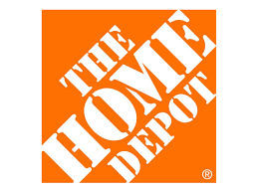
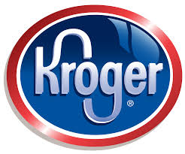
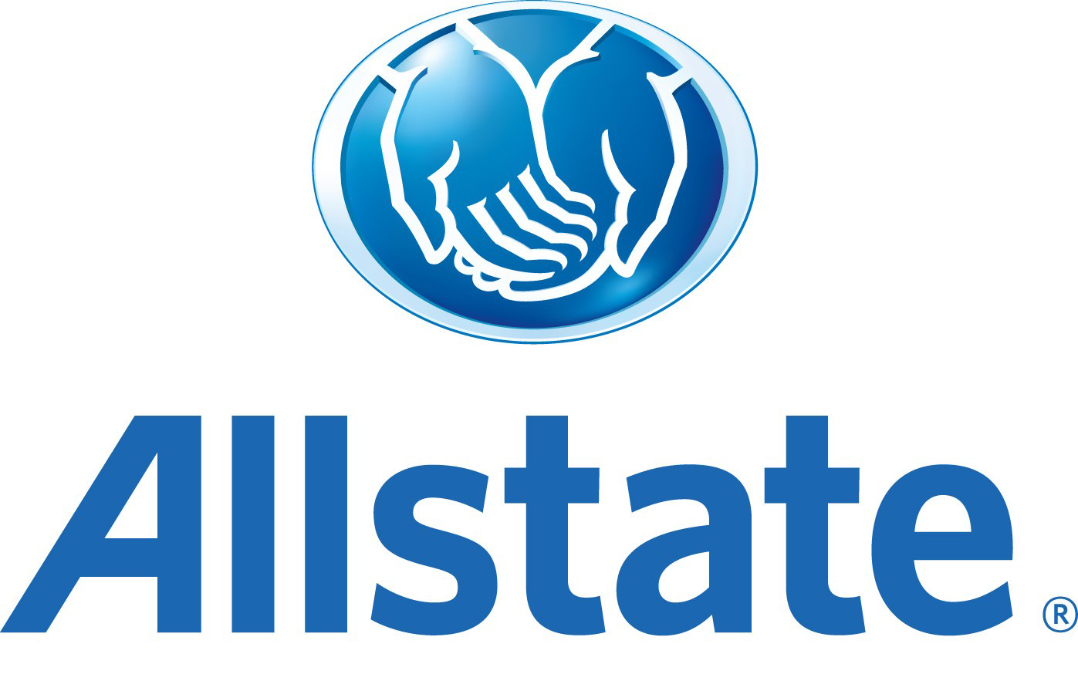
The Enterprise REVOLUTION
$138BN
$62BN
$34BN
$145BN
$108BN
$23BN
Notes:
However, we don’t hear as much about the as the massive enterprise revolution at play.
These are brick and mortar, solid revenue generating, dividend paying companies that are all adopting Pivotal Cloud Foundry and changing the way they build and deploy software.

Slide 18
The Enterprise REVOLUTION
700+ apps
Spring + PCF
Re-writing software the modern way
Agile software transformation
DevOps adoption with PCF
Automated build pipeline
Major IT transformation
Notes:
Speak to each of the companies

Slide 19
Cloud Ready Poll
App upgrades require planned outage?
Apps are hard to scale up or scale down?
App downtime when pulling cables at random in the datacenter?
19

Slide 20
It Takes a Platform
An end-to-end structured platform makes resilient distributed App
best practices, a turn-key,
first practice
20

Slide 21
Path to Full Stack Automation
Business Value, Agility & Cost Savings
Traditional IT
IaaS
Platforms
You Manage
Applications
You Manage
Applications
Applications
Data
Data
Data
You Manage
Runtime
Runtime
Runtime
Middleware
Middleware
Middleware
Pivotal CF
+
Choice of IaaS
O/S
O/S
O/S
Virtualization
Virtualization
Virtualization
Servers
Servers
IaaS
Servers
Storage
Storage
Storage
Networking
Networking
Networking
21

Slide 22


D e m o
Notes:
Scale Demo – its the fastest to stage
Do not go too deep into all the features if PCF.
This is an application status overview, we can scale an app, but wait to show high availability.
Session 2 will cover Org, Space, buildpacks, Containers, Scaling, etc
If this needs to be a full demo because stakeholders in the room, make sure not to talk too much to leave little time for the Labs, OK to deferr questions to the next Session on Arch and if the student is going to be in the lab for the rest of the workshop.

Slide 23
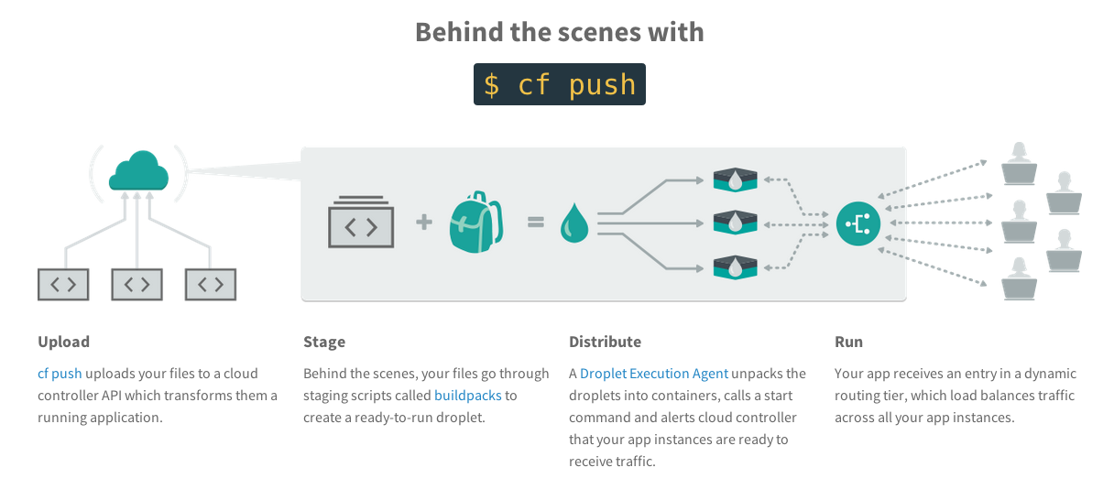
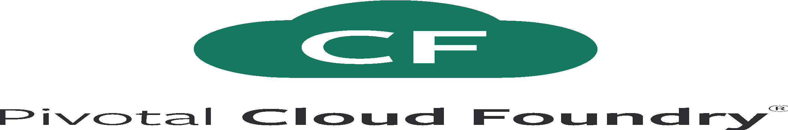
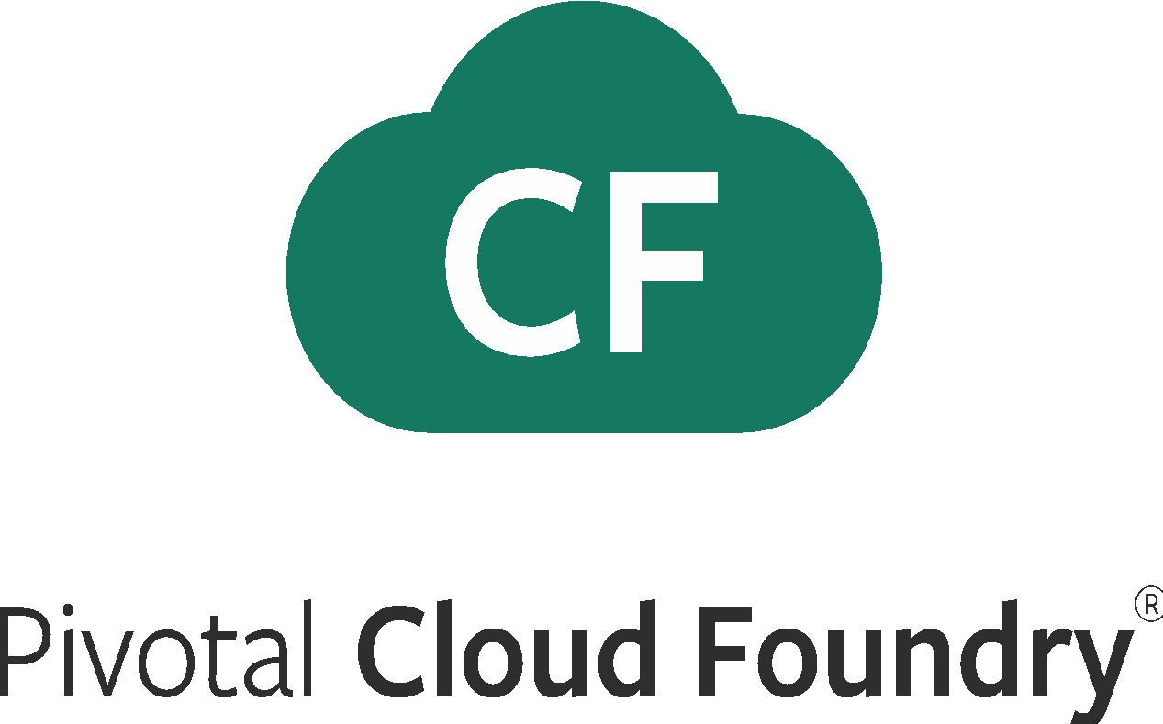
What Just Happened?
Notes:
Upload the bits
Stage: make a droplet
Distribute: execute in containers
Run: become routable

Slide 24
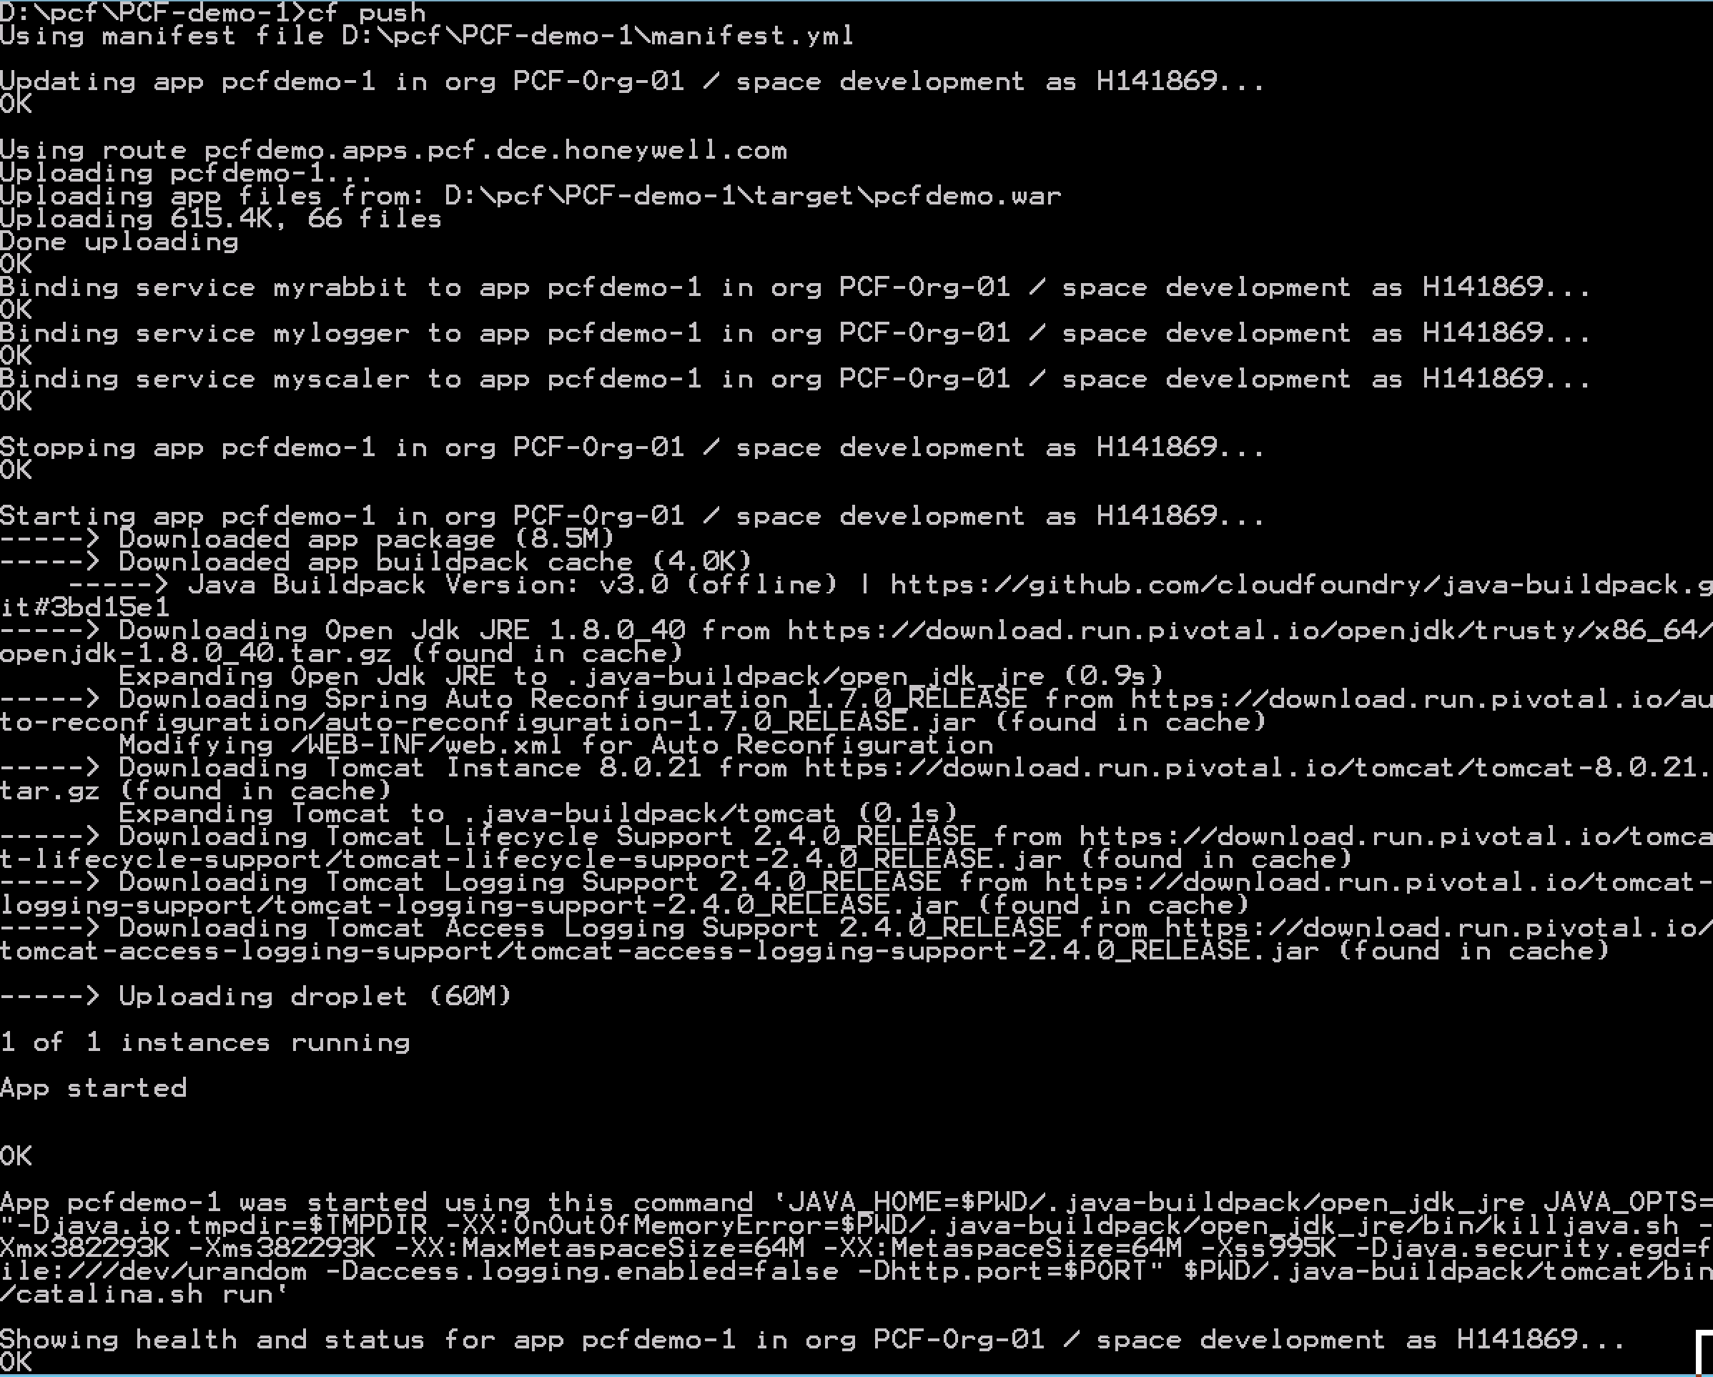
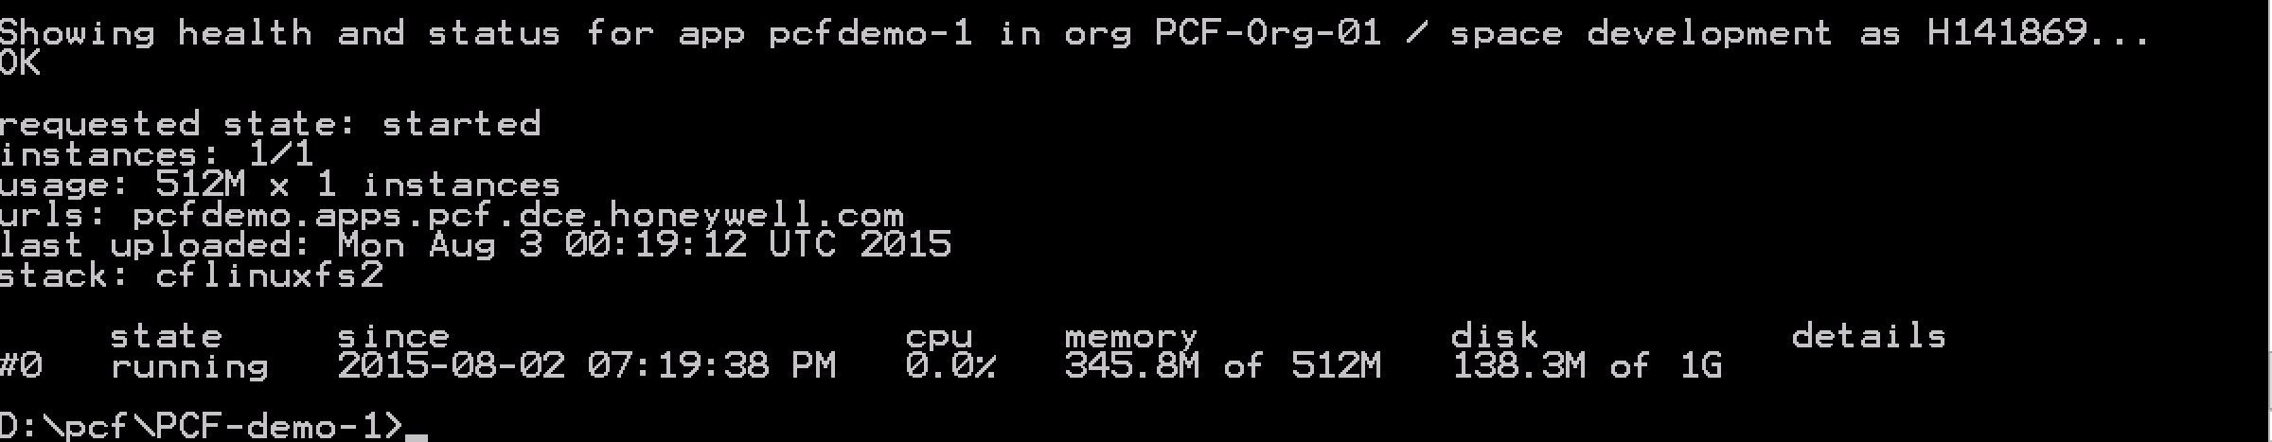
Full Stack Ticket Elimination
Firewall & Routes
Service Bindings
App Lifecycle
Runtime Installation & Config
Middleware Installation & Config
Application Installation & Config
App Lifecycle
Logging, Health, Telemetry

Slide 25
Pivotal Cloud Foundry at a Glance
Platform Runtime
Services
Routing
Container Scheduling
Service Discovery
Configuration
Database
Application Framework
Big Data
12 Factor Apps
Microservices
RESTful Services
Circuit Breakers
Object Storage
Mobile
Spring Boot
Ruby on Rails
Node.js
.NET
Build CI
User Provided
Logging & Metrics
Messaging
Operations
Zero Downtime Deployments
Failover & Recovery
Scaling
Security Patching
Platform
Upgrades
Azure

Slide 26
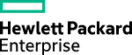
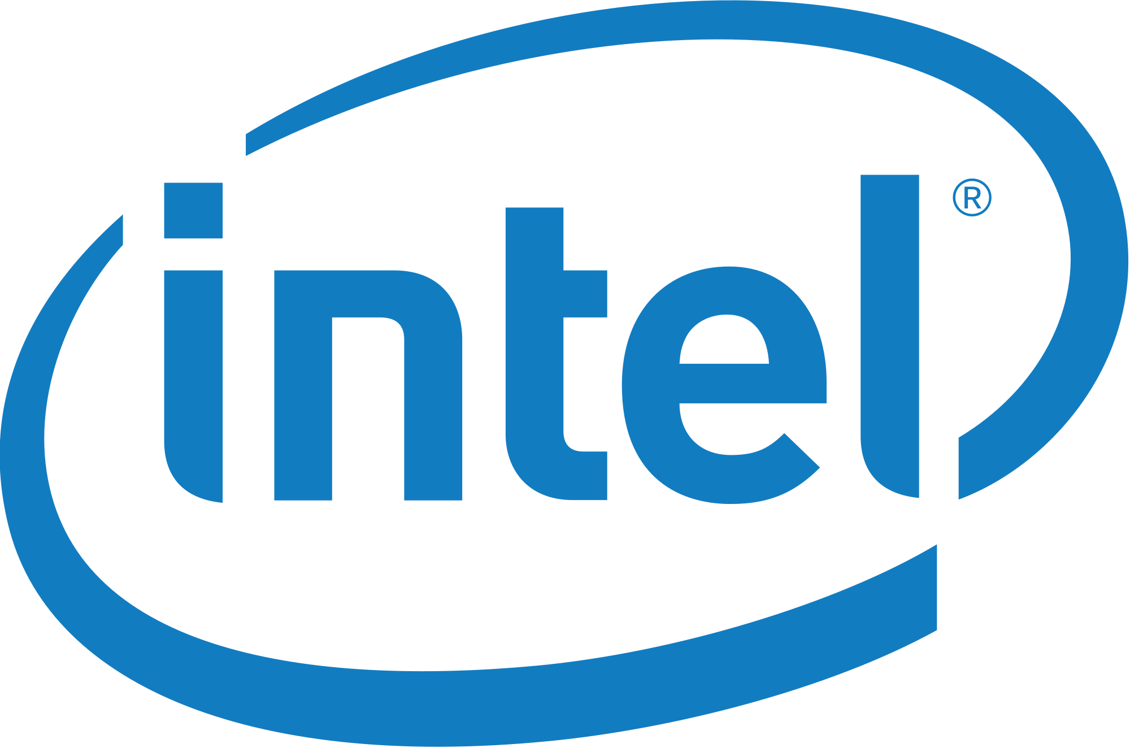
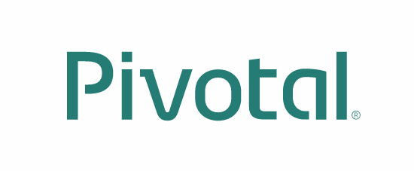





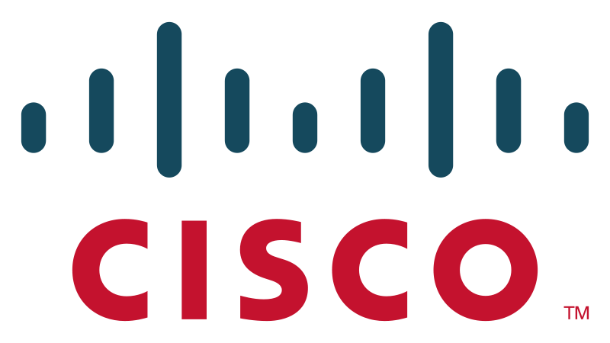





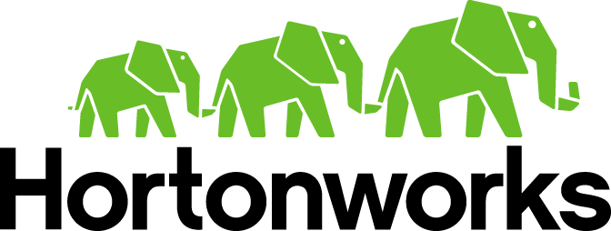





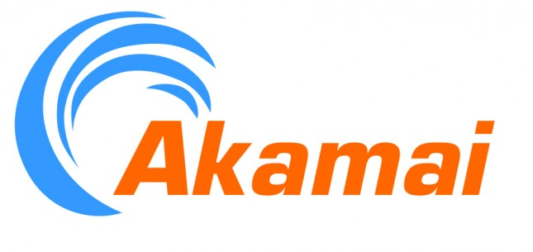







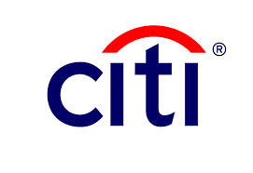
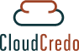



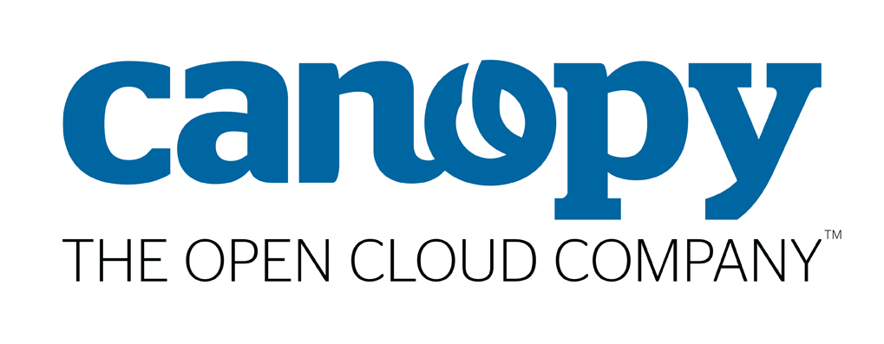






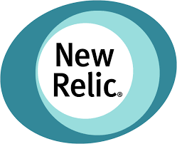




Pivotal Cloud Foundry: Most Trusted Platform
PLATINUM
GOLD
SILVER

Slide 27
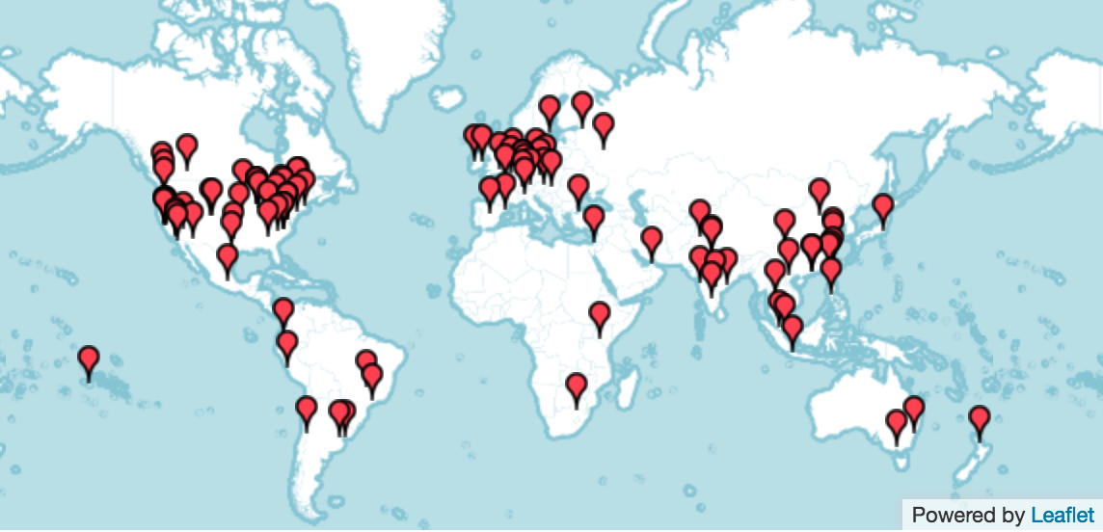
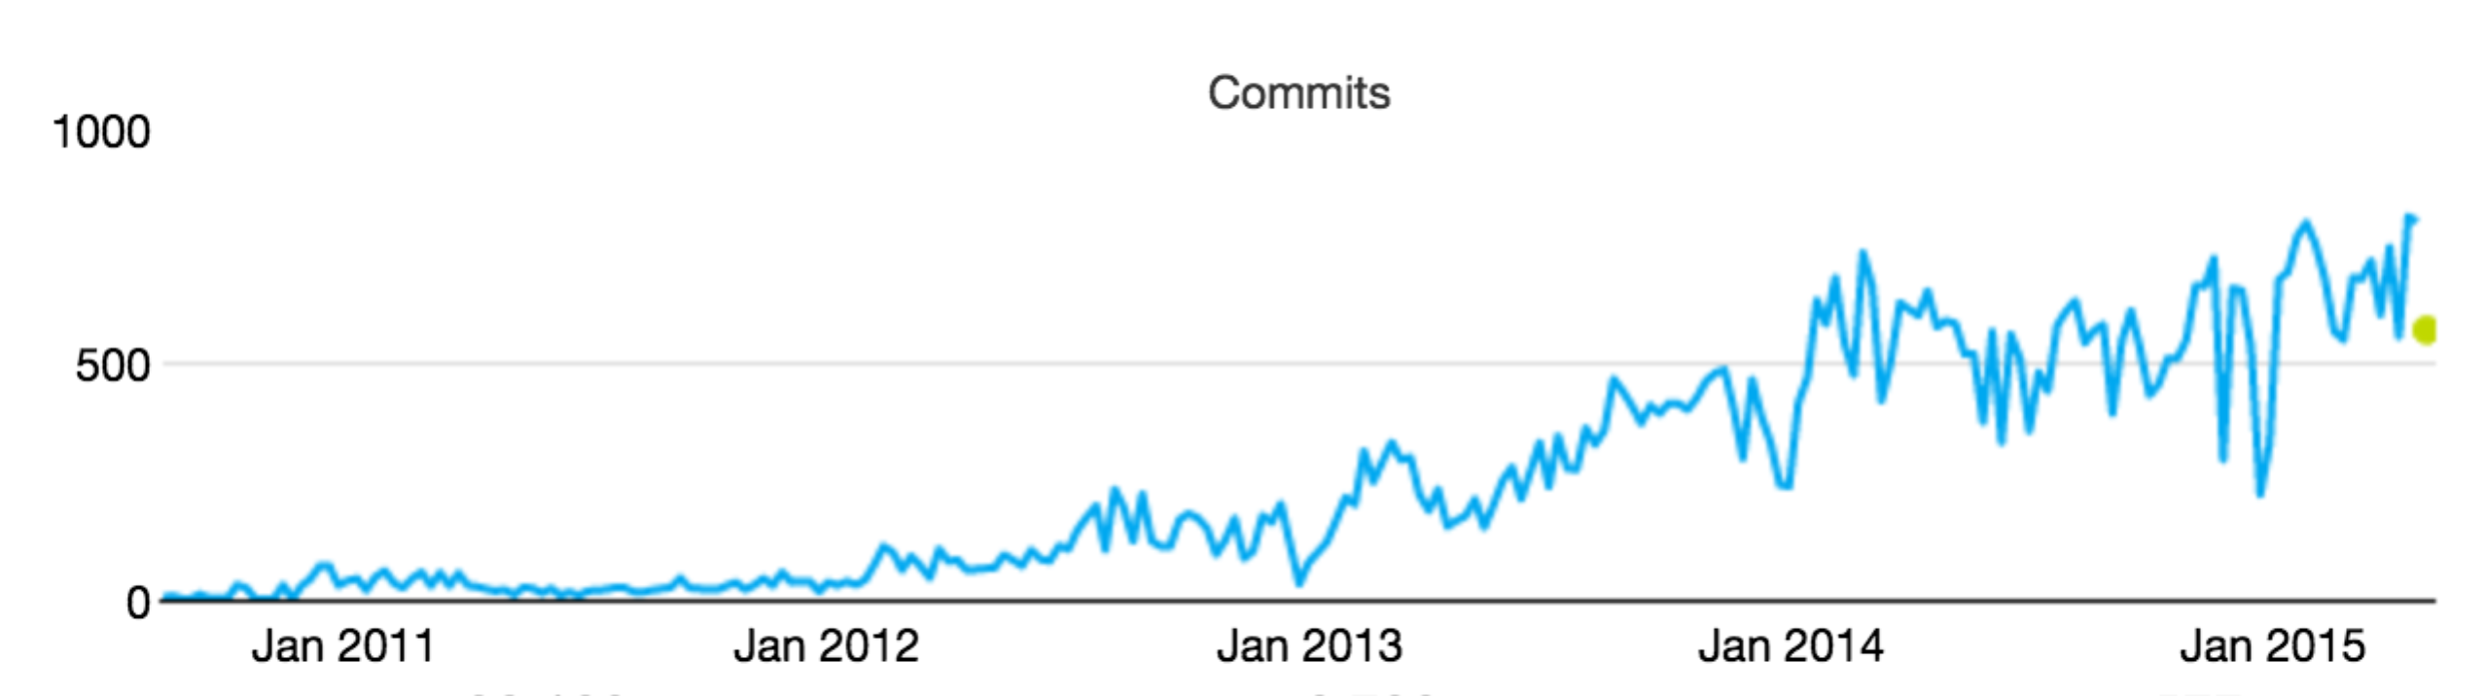
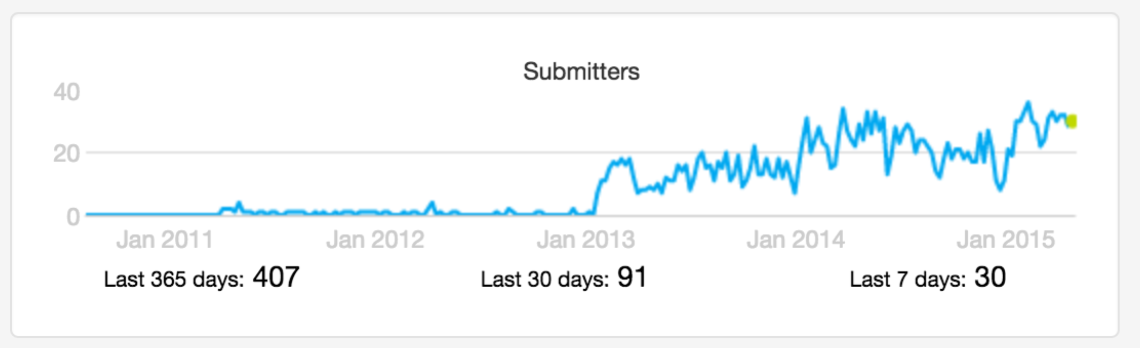
Cloud Foundry Open Source MOMENTUM
Commits
Submitters
53 corporations are contributing members
158 meet-ups in 49 countries
21K members with ~5K joining last month
~2200 developers, ~650 Code Submitters, ~400 of them in last year
65K commits with ~30K of those in the last year
Source: http://cloud-foundry.meetup.com/ on Jun 12 2015

Slide 28


Customer Results
“App in 10 weeks instead of 9 months”
“From 2 months for provisioning servers to deliver product in less than 5 weeks”
“The lean, agile product development practice we’ve stood up in partnership with Pivotal labs is a vehicle for cultural transformation.”
“18 lines of code to get a database, messaging middleware and an app server - kind of amazing!”
“Experience really been positive. Helped us become more “T” shaped engineers”

Slide 29

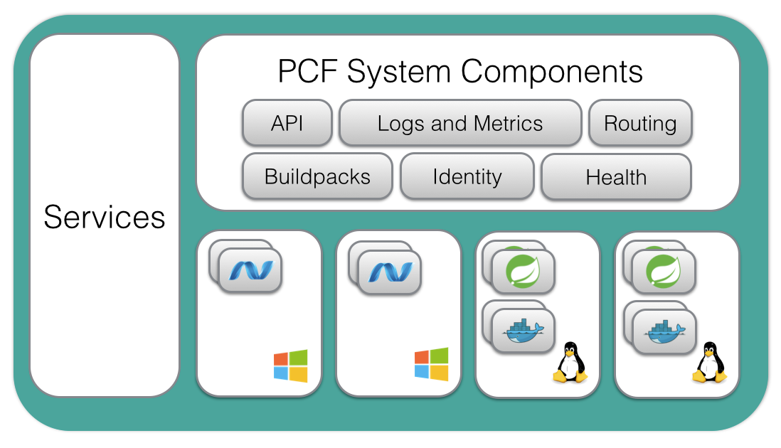



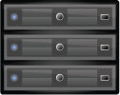


Disney’s Cloud Foundry
Location
Accessable
KMTC Data Center
(Corp Network)
ORACLE
vCenter
Network
Runs all your APIs and apps/services:
Ruby
NodeJS
Java
Python
PHP
Docker
.NET
…
SQL
Mongo
Corporate Network
BOSH
Legacy
Log in with:
[ EMC VNX]
https://apps.pivotalpoc.hosts.disney.pvt

Slide 30
B r e a k
Notes:
(bold moves)
2015 – This is..
The year where we see a level of adoption of our products and services that propels us to becoming an ipo-worthy company
This is..the year where our great vision becomes a reality in production environments at the most important companies and organizations in the world.
This is the year that we show and teach our customers and partners the power and opportunity that building great software brings.

